Slide 1


RENTAL LISTING INTEREST LEVELS
19CSE305-MACHINE LEARNING

Slide 2
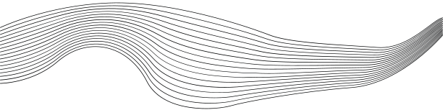
CONTENT
01
SENTIMENTAL ANALYSIS
02
PROBAVILISTIC MODEL
03
UNSUPERVISED MODEL
04
ENSEMBLE MODEL

Slide 3
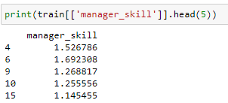
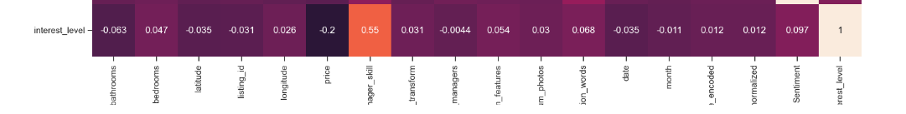

Slide 4
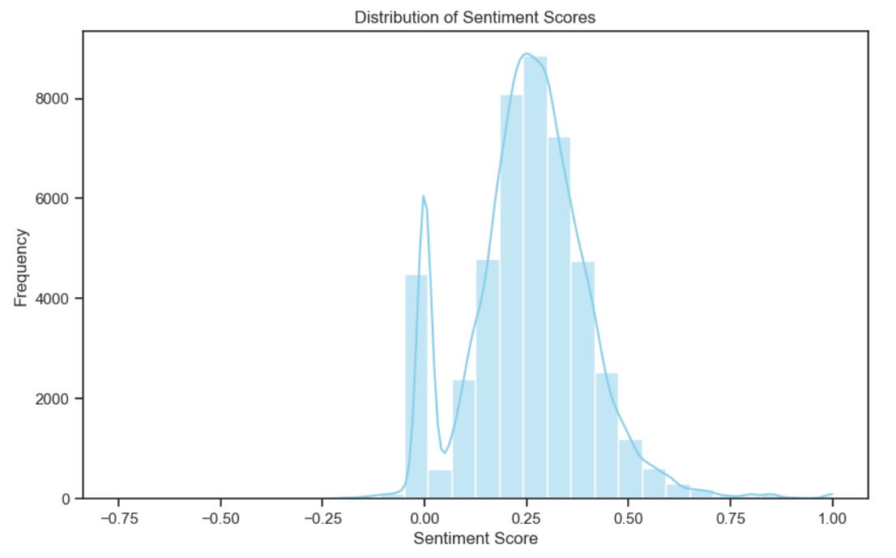
Sentimental Analysis
We Have converted the text data into Numerical Data using TEXTBLOB
The distribution appears to be approximately normal, with fewer texts having very negative or very positive sentiment scores.
The majority of the sentiment scores fall between 0.25 and 0.75, indicating that most of the text data has a sentiment that is slightly positive

Slide 5
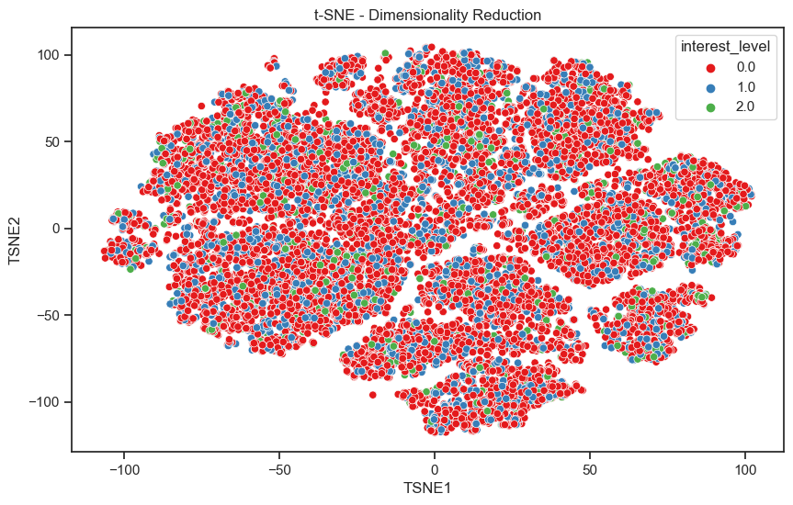


DIMENSIONALITY REDUCTION USING T-SNE

Slide 6
PROBABILISTIC MODEL

Slide 7
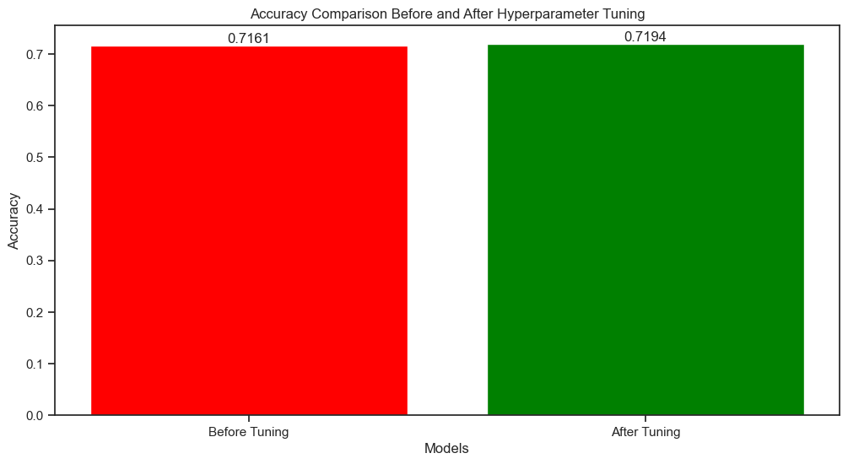
GAUSSIANNB
The red bar represents the accuracy of the model before hyperparameter tuning, which is 0.7161. The green bar represents the accuracy of the model after hyperparameter tuning, which is 0.7194.

Slide 8
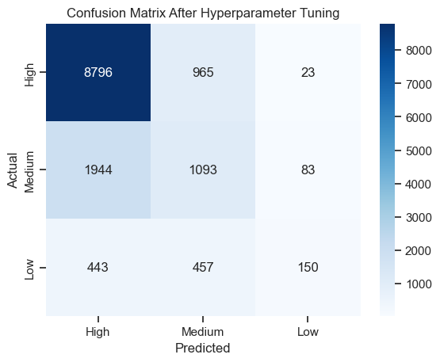
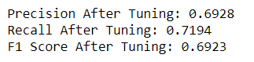
CONFUSION MATRIX

Slide 9
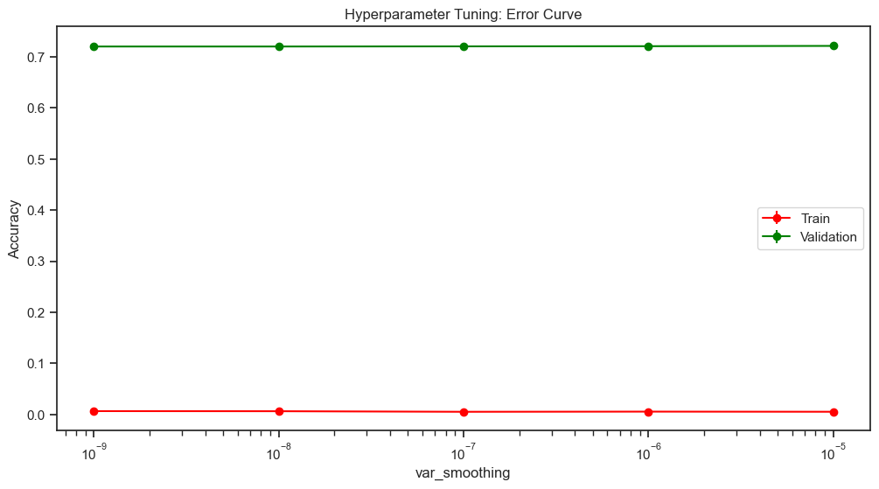
ERROR - CURVE

Slide 10
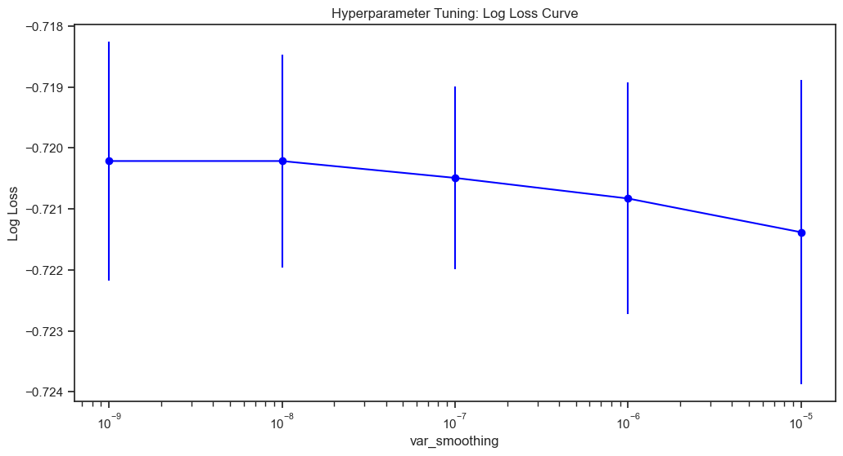
LOGLOSS-CURVE

Slide 11
Hidden Markov Model

Slide 12
A hidden Markov model (HMM) is a statistical model that can be used to describe the evolution of observable events that depend on internal factors, which are not directly observable.

Slide 13
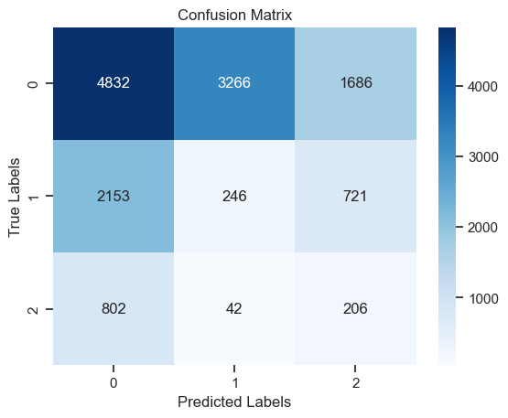
confusion matrix

Slide 14
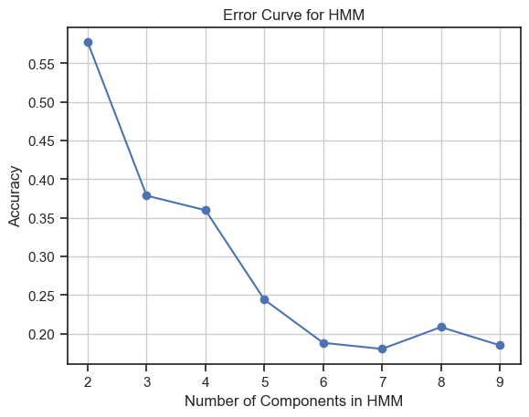
error-curve

Slide 15
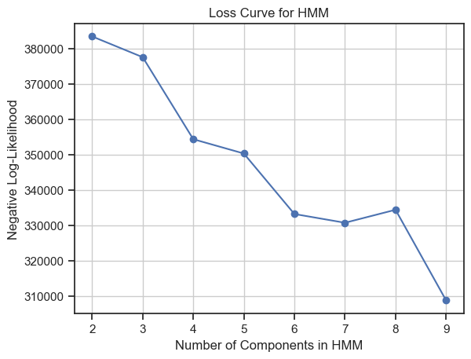
Loss curve

Slide 16
UNSUPERVISED LEARNING

Slide 17
KMEANS CLUSTERING

Slide 18
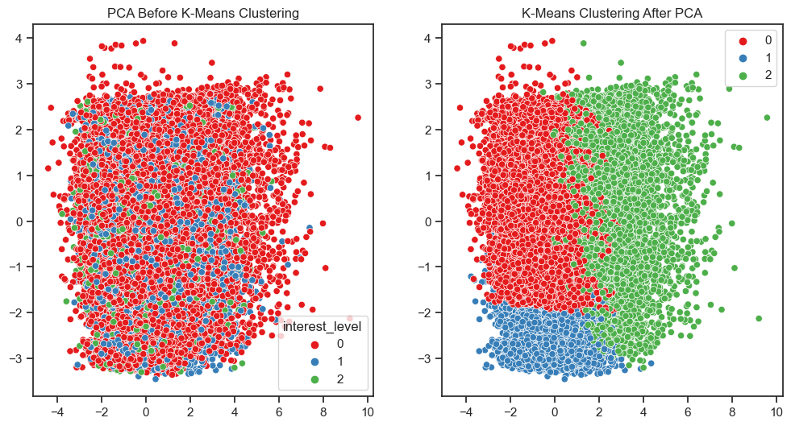
K-means clustering divides the dataset into a predefined number of clusters (k), ensuring each data point belongs to the group that has similar properties

Slide 19
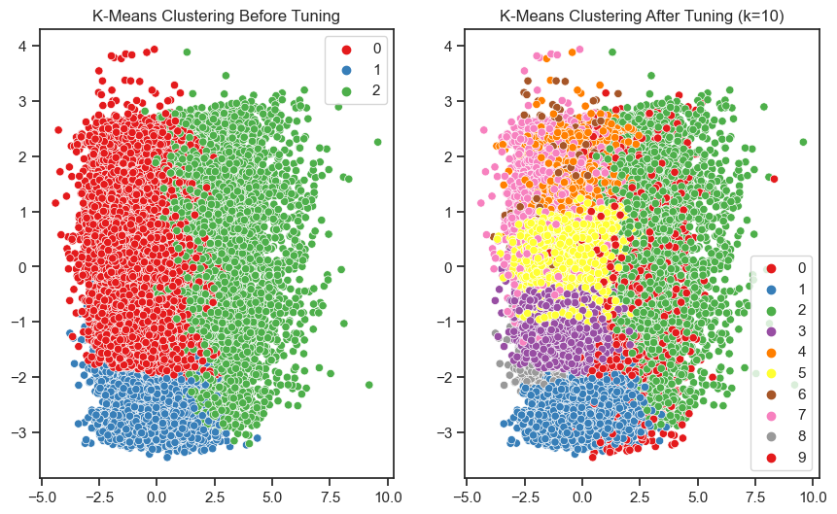
Tuning for k in k-means clustering is crucial to find the optimal number of clusters, ensuring meaningful patterns and avoiding underfitting or overfitting

Slide 20
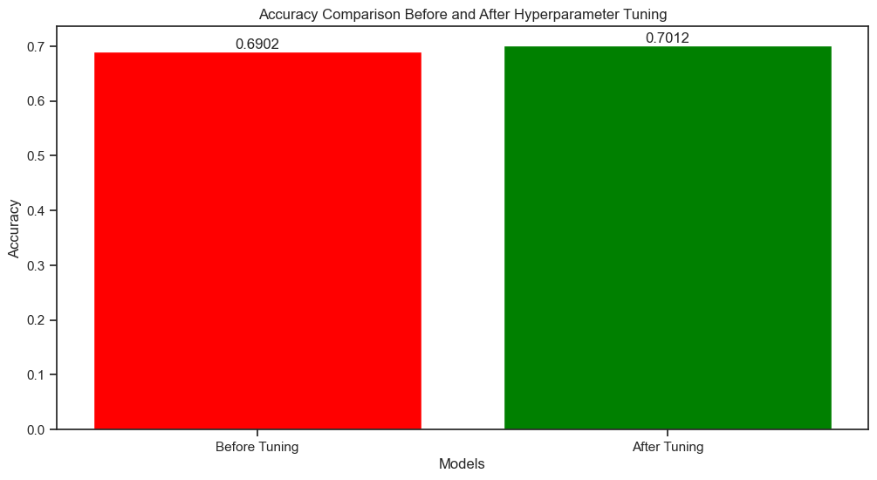
accurracy

Slide 21
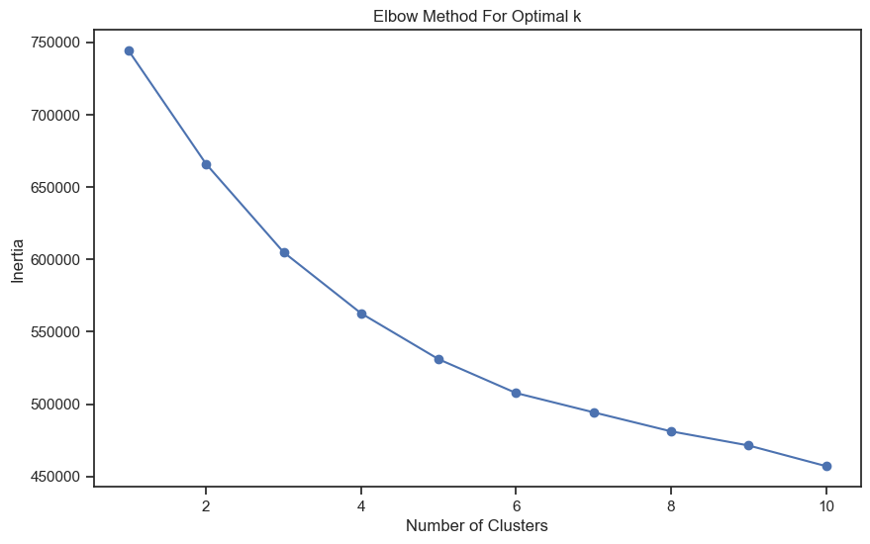
The optimal number of clusters is where the rate of decrease sharply shifts, which is the “elbow” of the plot. In your case, it’s around 10 clusters.

Slide 22
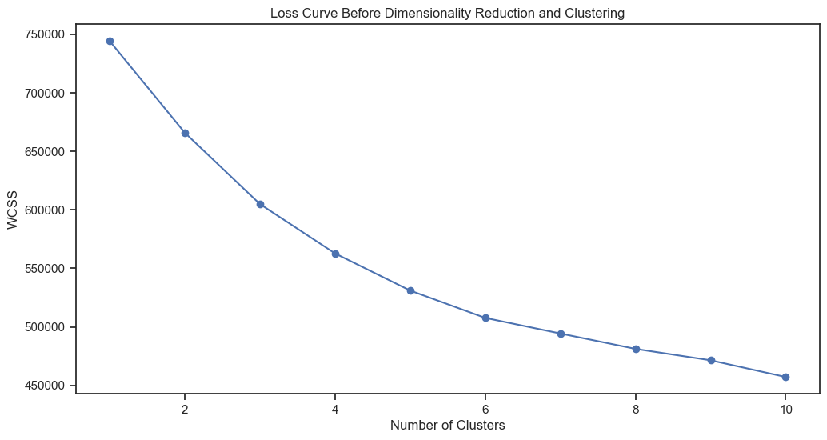
loss-curve
sum of square distances between the centroids and each points.

Slide 23
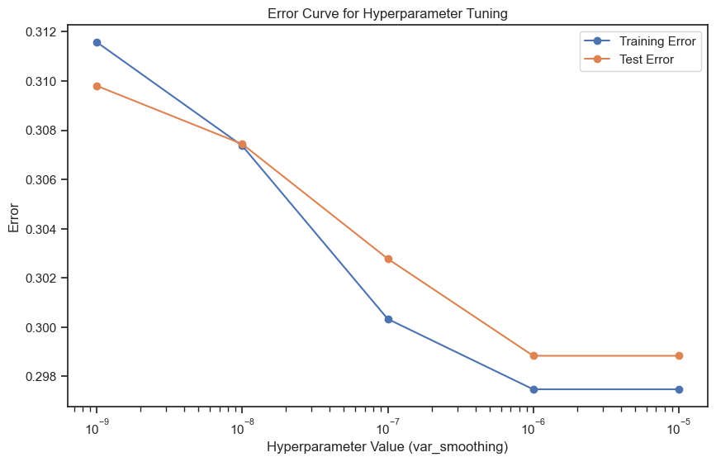
error curve

Slide 24
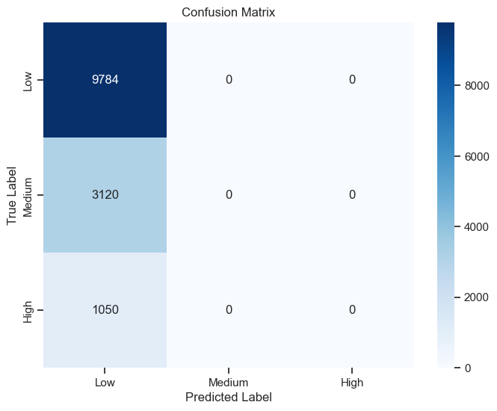
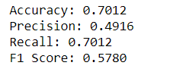
confusion matrix

Slide 25
Principal Component Analysis

Slide 26
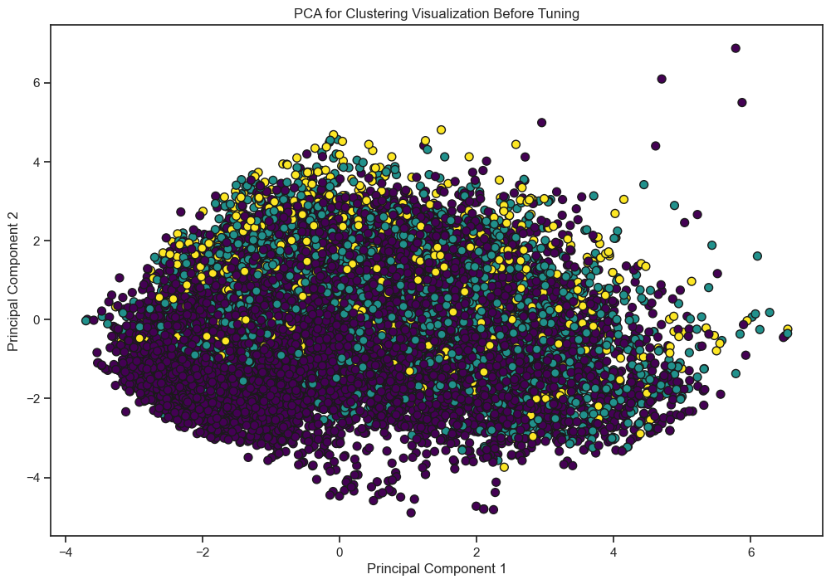
we done PCA clustring with GaussianNB

Slide 27
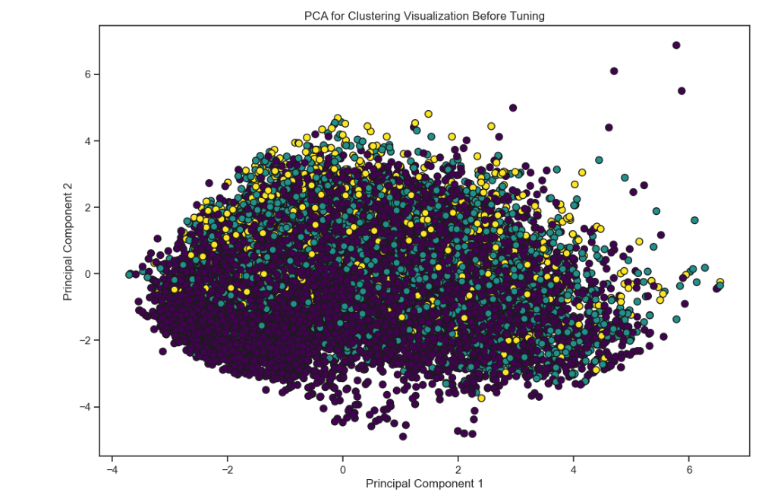

Slide 28
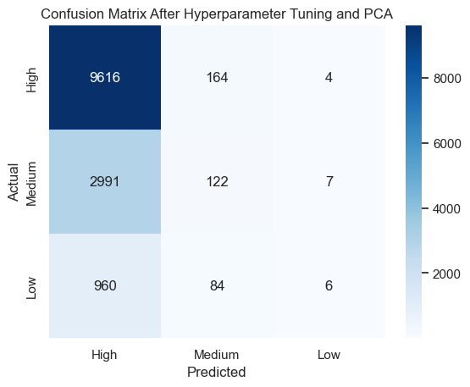
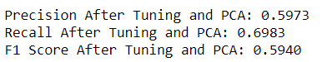
confusion matrix

Slide 29
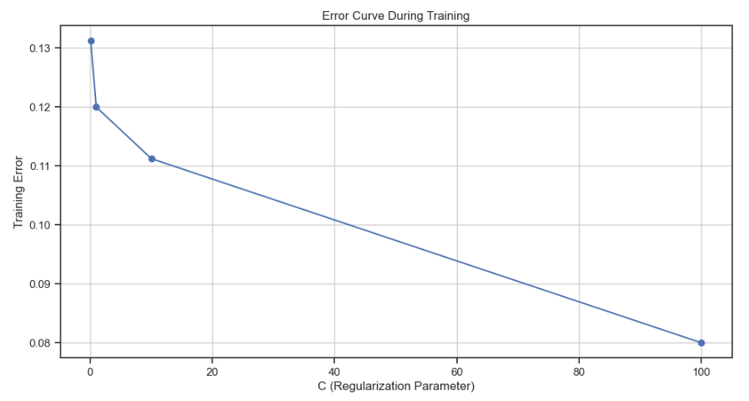
error-curve

Slide 30
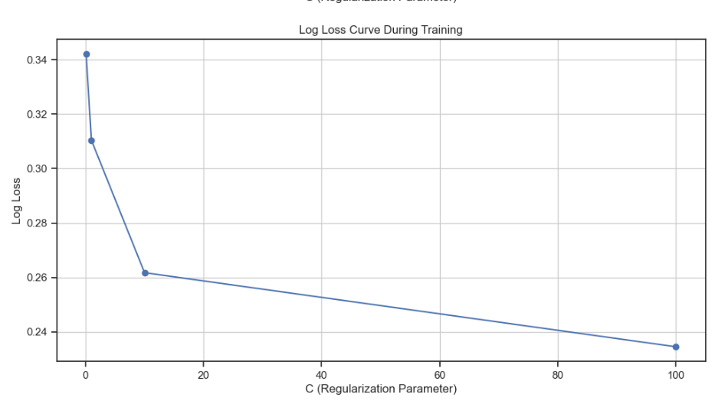
logloss-curve

Slide 31
ENSEMBLE MODEL

Slide 32
Ensemble model with RandomForestClassifier + AdaBoostClassifier

Slide 33
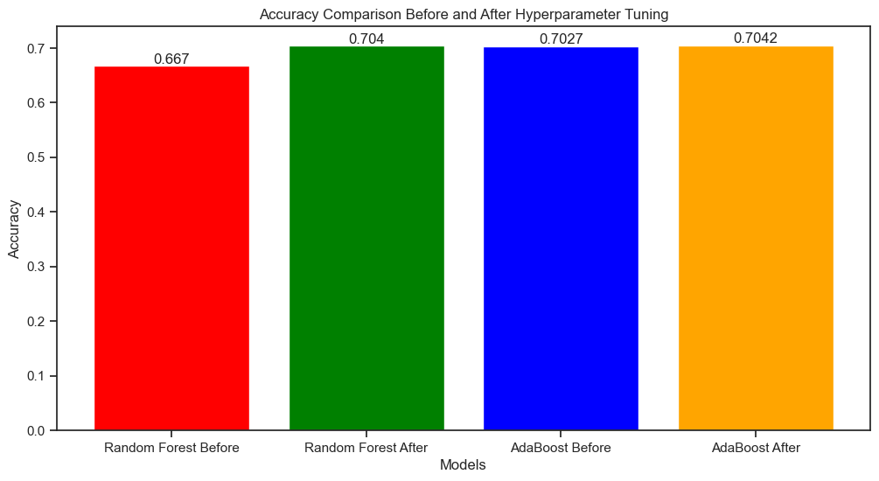
The bar graph compares model accuracies before and after hyperparameter tuning. It shows that tuning improves the performance of both Random Forest and AdaBoost models.

Slide 34
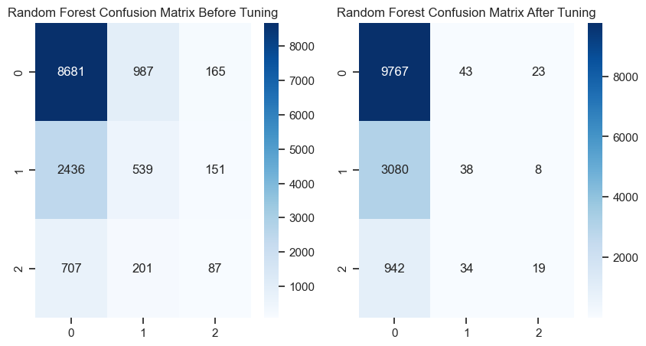
confusion matrix for random forest

Slide 35
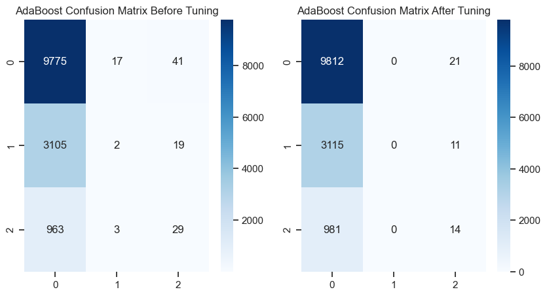
confusion matrix for ada-boost

Slide 36
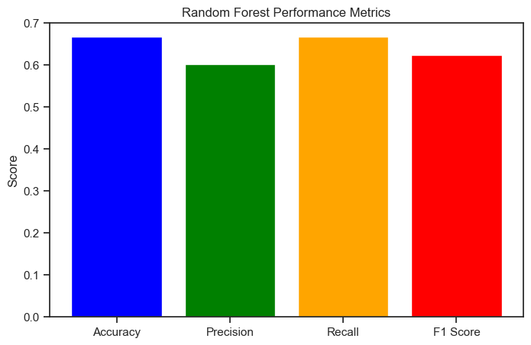
The bar graph illustrates the performance metrics of a random forest model, highlighting scores for accuracy, precision, recall, and F1 score.

Slide 37
Ensemble Model with RandomForestClassifier, GradientBoostingClassifier, StackingClassifier, BaggingClassifier, AdaBoostClassifier, VotingClassifier

Slide 38
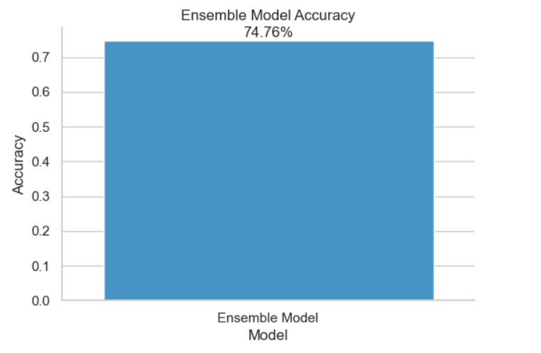

Slide 39
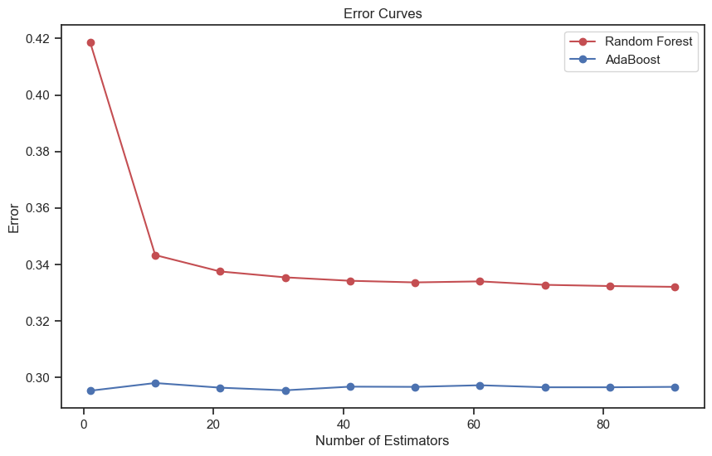
error curve

Slide 40
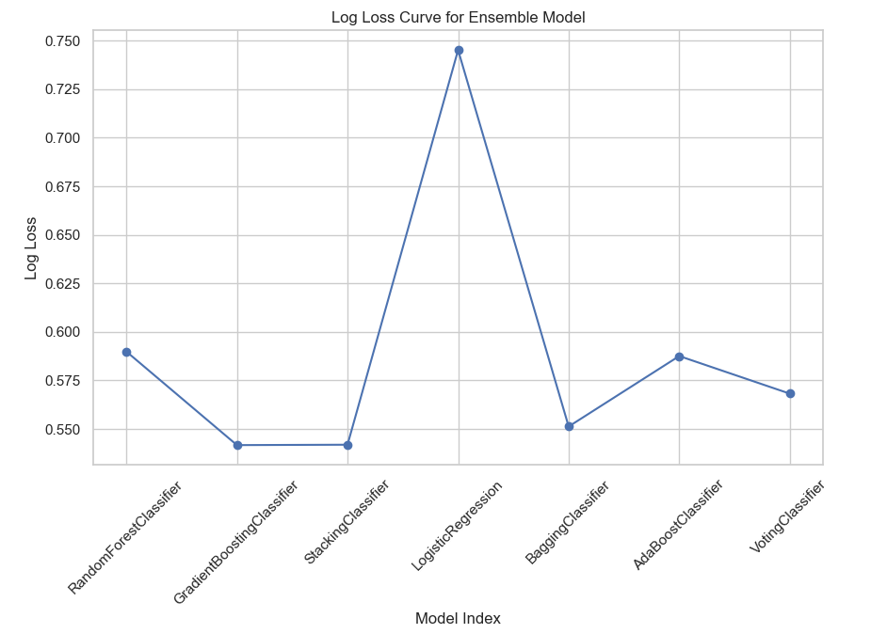
logloss-curve

Slide 41
Ensemble Modal with KNN MSE,Bayesian Ridge MSE, Gaussian NB MSE, Ensemble (KNN + Bayesian Ridge) MSE

Slide 42
